Slide 1
Machine Learning Final Project
Cesar Zea
November 2023

Slide 2
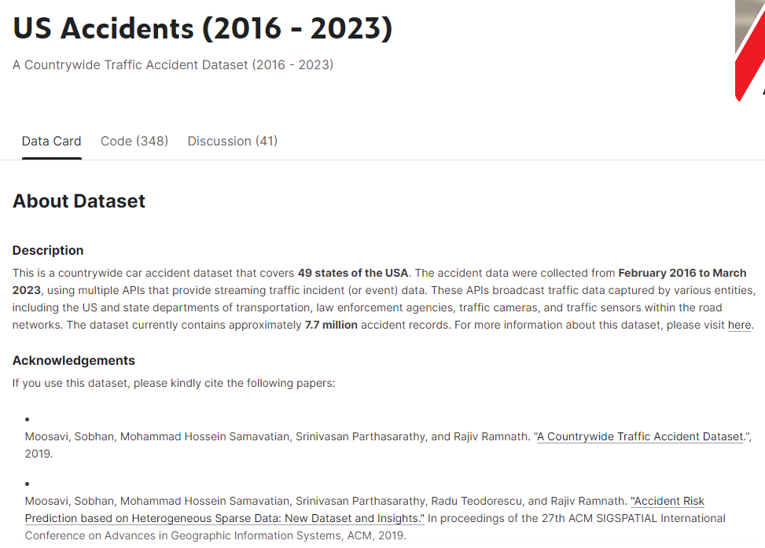
Data set: https://www.kaggle.com/datasets/sobhanmoosavi/us-accidents
The data was found in Kaggle.com
It contains 7728394 rows × 46 columns
For more information click here: https://smoosavi.org/datasets/us_accidents

Slide 3
Project Scope
Problem Statement: Predict accident severity based on other variables.
Technology Stack:
Utilize Python and libraries such as Pandas, Scikit-learn, Keras, and TensorFlow.
Employ Tableau for dynamic and interactive visualizations and Exploratory Data Analysis.
Step 1: Cleaning the data for EDA
Step 2: Tableau Exploratory Data Analysis (EDA)
Step 3: Cleaning the data for Machine Learning Models
Step 4: Final preparation for the models
Step 5: Model Selection and Execution
Step 6: Model optimization
Recommendations

Slide 4



Step 1: Cleaning the data for EDA
The original file is 7728394 rows × 46 columns. This is too large for Tableau Public.
A random sample of the original dataset was selected (50% of the original dataset).
Maintained proper representation. The comparison between data sets shows that the difference is minimal: The maximum City Proportion difference is for Miami: 0.000013.

Slide 5
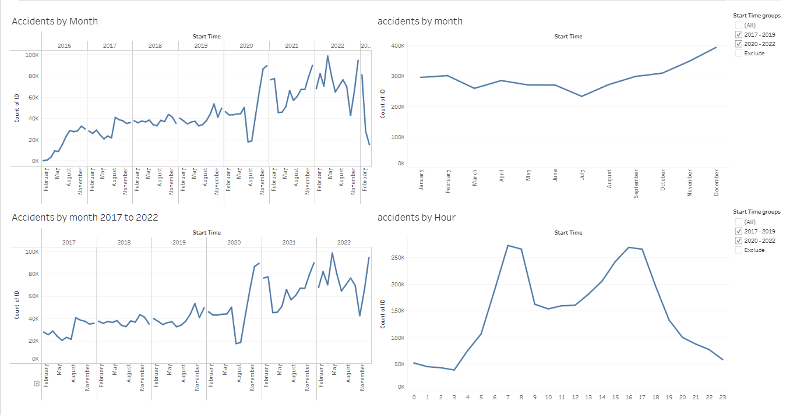
Step 2: Tableau Exploratory Data Analysis (EDA)
Data for the years 2016 and 2023 are unreliable.
Focusing on 2017 to 2022, and increase in the number of accidents in 2019 is noticeable, with high numbers persisting afterwards.
Overall, November and December consistently had the most accidents. October was the most active month pre-pandemic. December and November are more active post-pandemic. This may reflect behavioral changes post-pandemic, such as increased remote or hybrid work.
There are also noticeable changes in the peak hours for accidents. Overall, the peak hours are between 7 to 8 AM and 4 to 5 PM. Pre-pandemic the 7 to 8 AM slot was significantly more active. Conversely, during post-pandemic years the evening peak became more prominent.
Based on these observations, we can conclude that behavioral changes influenced the periods and timing of peak accident activity in the US.
US Accidents Analysis - CZ | Tableau Public

Slide 6
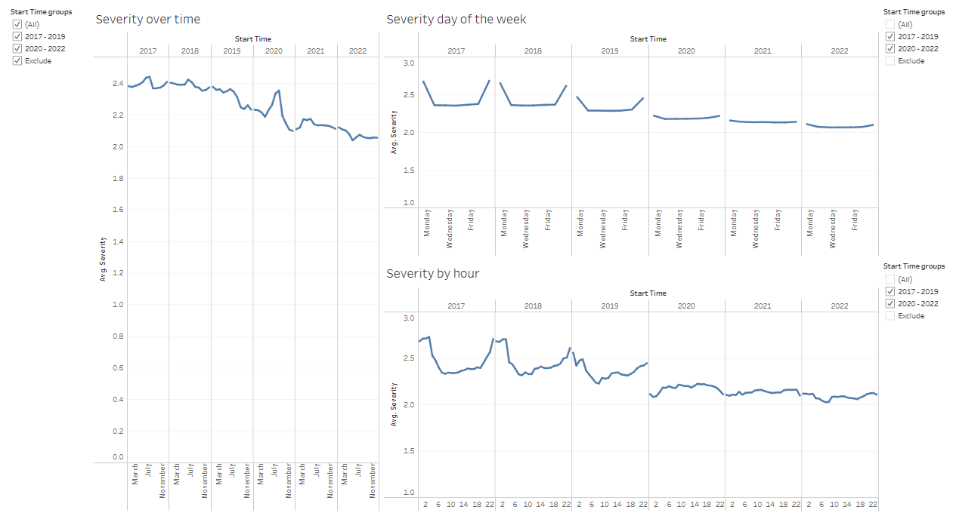
Step 2: Tableau Exploratory Data Analysis (EDA), Cont.
Severity of accidents declined over the years. The average severity in 2017 was 2.4, which decreased to 2.1 in 2022.
The most significant decline in severity was observed in 2020. This could be due to changes in driving habits, resulting in fewer accidents. Efficiency and effectiveness handling accidents could have also improved.
Although Saturday and Sunday have the lowest number of accidents, the severity on these days is higher.
Finally, the time of day with the highest severity is between 10 PM and 3 AM. However, even this trend is showing improvement.
US Accidents Analysis - CZ | Tableau Public

Slide 7
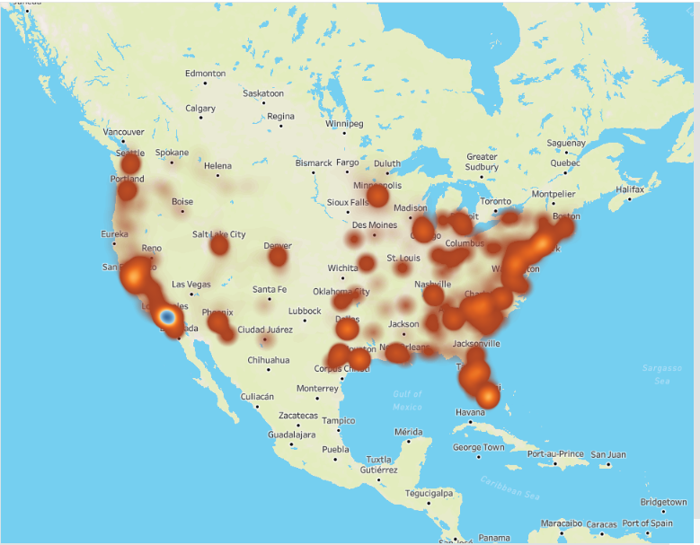
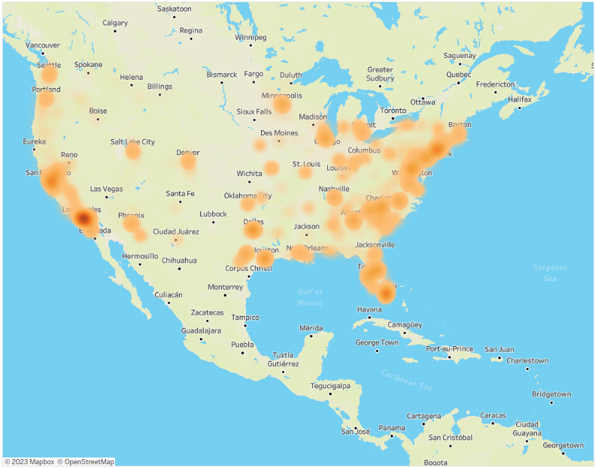
Step 2: Tableau Exploratory Data Analysis (EDA ), Cont.
There appears to be a correlation between geolocation and the frequency of accidents, with the East Coast and Southwest Coast regions being particularly active.
The severity of accidents also appears to have a geographical correlation, with the Southwest Coast and the Southeast Coast exhibiting higher severity averages.
Number of Accidents
US Accidents Map | Tableau Public
Severity

Slide 8

Step 3: Cleaning the data for Machine Learning Models
Based on the EDA, we'll drop all the rows for years 2016 and 2023.
Eliminate columns End_Lat, End_Lng, Street, City, Airport_Code, Weather_Timestamp, Wind_Chill(F), Wind_Direction, Sunrise_Sunset, Civil_Twilight, Nautical_Twilight, Description, Timezone, Zipcode, ID, County, Source, End_Time, Country.
Missing data in columns Temperature(F), Humidity(%), Pressure(in), Visibility(mi), Wind_Speed(mph), Precipitation(in): fill with the avg. of the other scores in the same column.
Weather_Condition: Fill with "NA"
Clean the 'Weather_Condition' column grouping the different options: 133 options to 14.
Encode the Object variables: 'State', 'Weather_Condition', 'Astronomical_Twilight'.
Found correlations between Features to see if there were redundant ones. Droped 'Astronomical_Twilight_Day'

Slide 9



Step 4: Final preparation for the models
Split the data in features and target.
Split the data into training and testing sets.
Scaled the data.

Slide 10
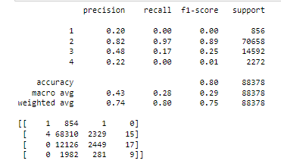
Step 5: Model Selection and Execution Model 1: Logistic Regression
The model shows strong precision and recall for Class 2, and decent scores for Class 3.
Results are poor for Classes 1 and 4.
Sample imbalance.
Overall accuracy 80%, but poor at recognizing classes, especially for 1 and 4.

Slide 11
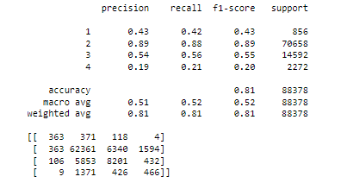
Step 5: Model Selection and Execution Model 2: Logistic Regression
Improvement in classes 1 and 3 vs. the logistic regression model.
Still shows poor results for class 4.
Class 2 results are the strongest ones, due to its large representation in the dataset.

Slide 12
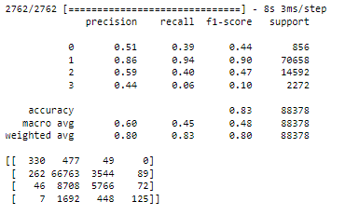
Step 5: Model Selection and Execution Model 3: Logistic Regression
Most accurate with severity level 2 predictions.
Severity levels 1 and 4 have particularly low recall.
The model struggles with distinguishing between severity level 3 and 4.
The accuracy seems high at 0.83, but this might be misleading.

Slide 13
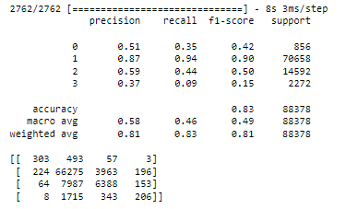
Step 6: Model optimization
Methods tried to optimize and failed:
Revising the Features:
Eliminated the States.
Eliminated some columns that could have low impact on severity: 'Amenity', 'No_Exit', 'Railway', 'Station’
Applied SMOTE method to deal with the imbalance of the sample.
For the Deep Neural Model: went from 'epochs=10, batch_size=50' to 'epochs=20, batch_size=50'
Comparing the results between pre and post optimization for the Deep Neural Model:
Better identification of the more severe cases (level 4). Overall accuracy of the model has remained stable.
Improvement in recall for severity levels 3 and 4.
In summary, the optimization has led to the model being more sensitive to higher severity levels, which can be critical.

Slide 14

Recommendations
Explore Feature Engineering: combining features or further evaluating correlations.
Address Class Imbalance: explore different sampling options, or apply weighting to the different classes.
Explore options to select features: consult with experts on accidents to better select features that would have impact on severity.

